Slide 1

MTA Turnstile Exploratory Data Analysis
presentation by : Hesham Doom

Slide 2
Outline
Backstory
Design:
Data
Data Engineering
Visualization and Graphs
Conclusion and summary
Recommendations

Slide 3
Backstory
We received an official request from the planning authorities to know the most crowded places on the transportation network to control the upcoming tourist season. The data must be processed and shared with the relevant actors.

Slide 4

Design:
First of all I scrapped the data from the website of MTA data (http://web.mta.info/developers/turnstile.html).
Starting from scrapping around three months of data from June to August and
putting them in sql file in a table called test then
applying some data cleaning , adding some columns help us in visualization,
finally plot the graphs and get more intuition about the data and total traffic.

Slide 5

Data:
New York subway MTA turnstile data is a series of data files containing cumulative number of entries and exits by station, turnstile, date and time.
Data files are produced weekly, data records are collected typically every 4 hours with some exceptions.
the data which I used to analyze is from June to August for 2020 year.

Slide 6
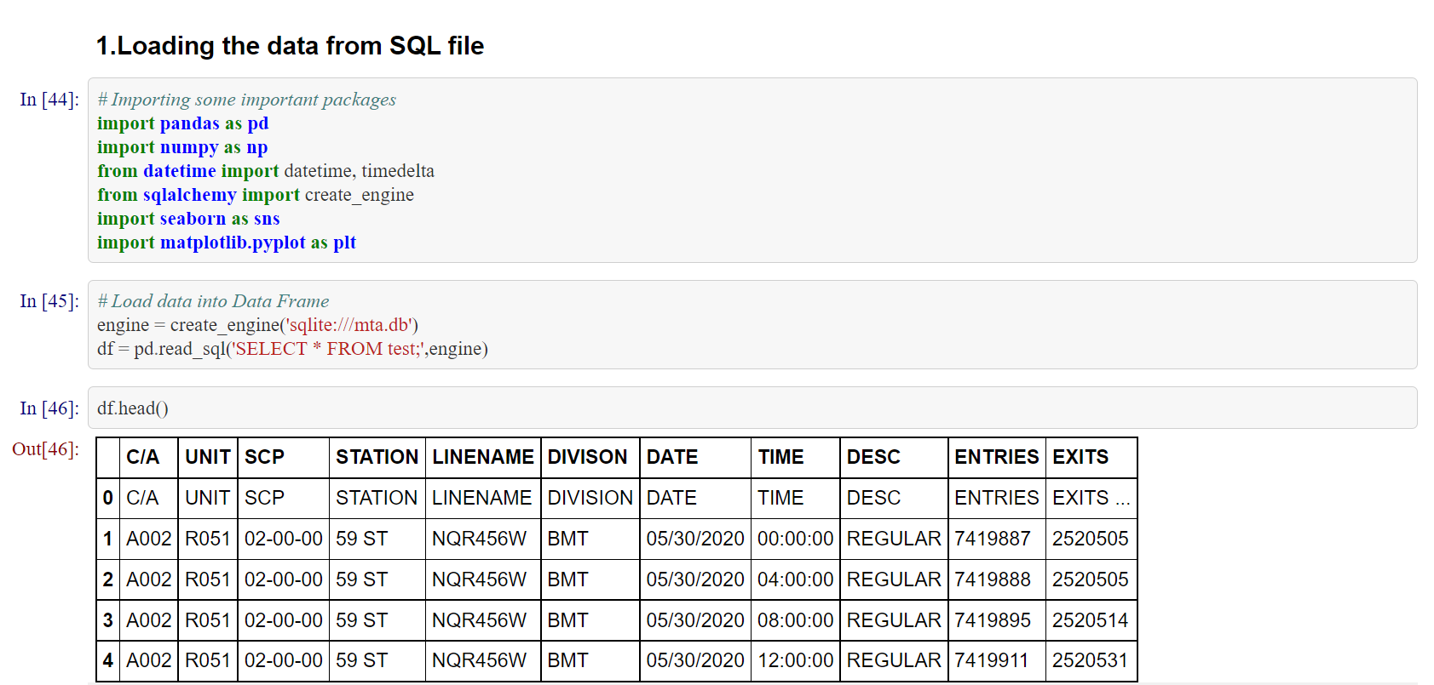
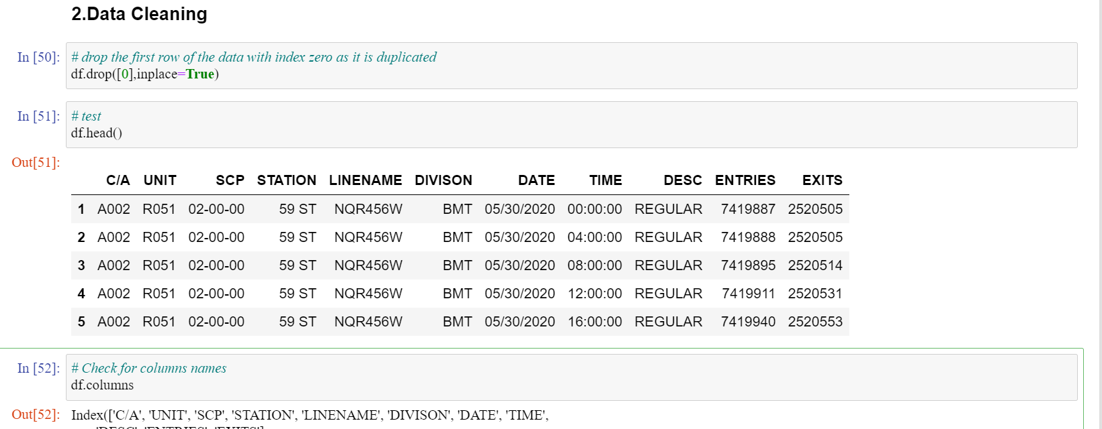
Data Engineering - Loading the data from SQL file -Cleaning the data

Slide 7
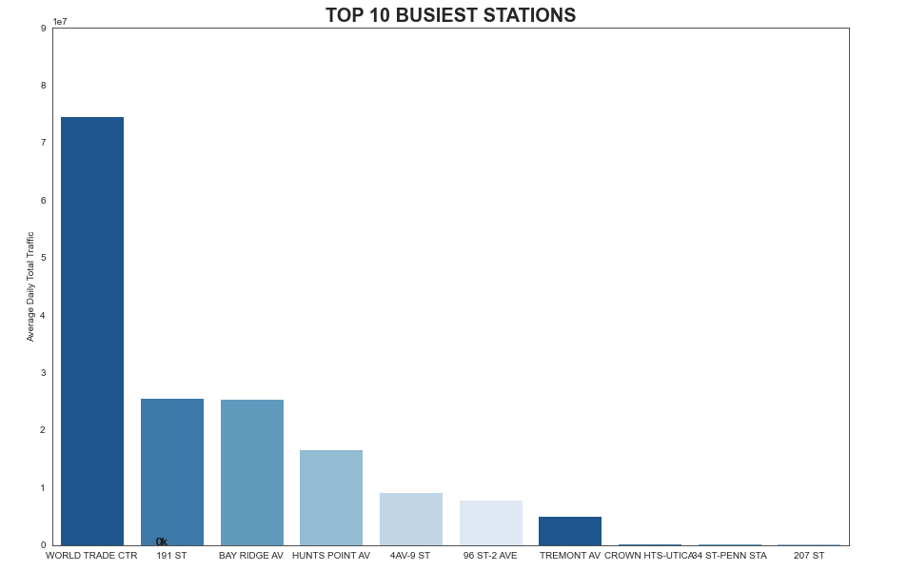
Visualization and Graphs - Plot the most busiest stations Barplot for top 10 busiest subway

Slide 8
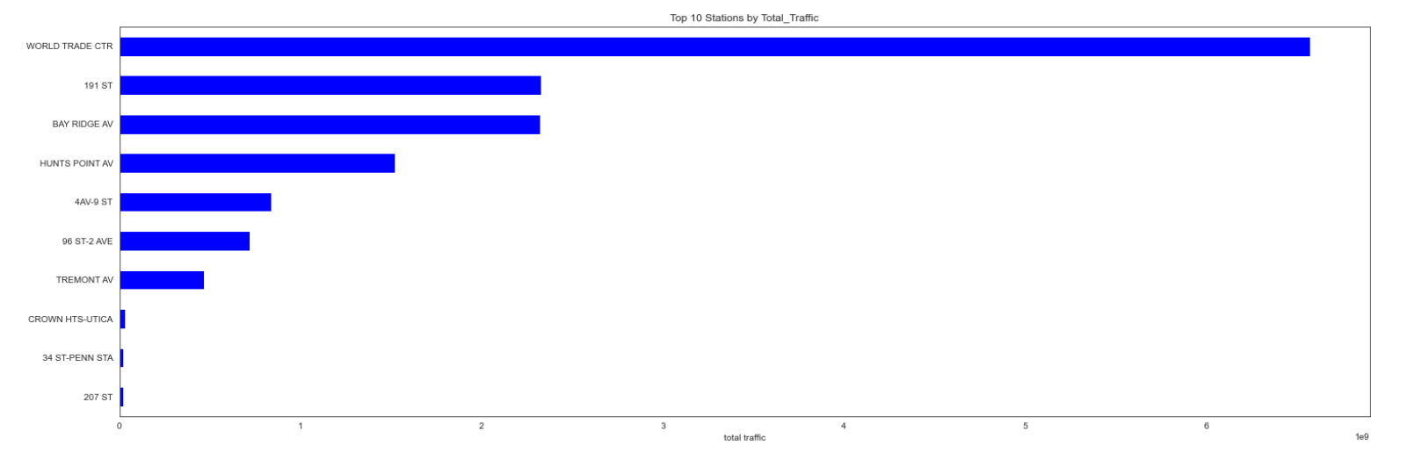
Visualization and Graphs - Plot the most busiest stations Barplot for top 10 busiest subway

Slide 9
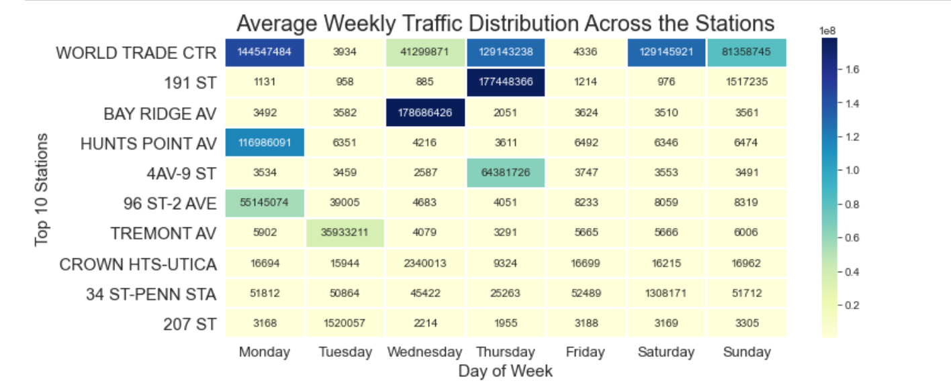
Visualization and Graphs - Plot the most busiest stations Barplot for top 10 busiest subway

Slide 10
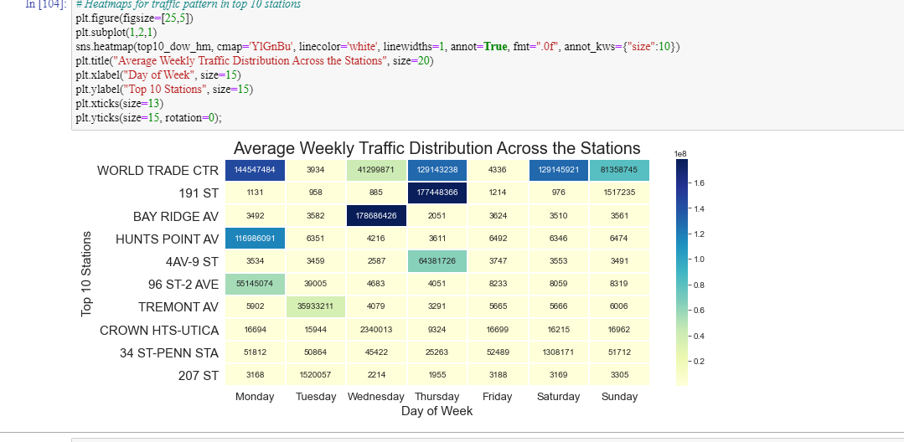
Conclusion and summary Top most days which have a most traffic

Slide 11
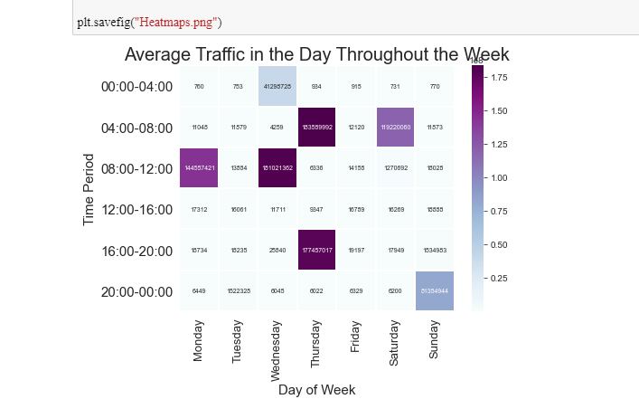
Conclusion and summary Top most days which have a most traffic

Slide 12

Recommendations
1.from the above Exploratory Data analysis we can conclude that the most traffic station is the "world trade CTR" station as we see this from the above plots. we also can deduce that the top 10 stations which have most traffics are ['WORLD TRADE CTR', '191 ST', 'BAY RIDGE AV', 'HUNTS POINT AV', '4AV-9 ST', '96 ST-2 AVE', 'TREMONT AV', 'CROWN HTS-UTICA', '207 ST', 'BOWERY']. Also we can see that Monday is the most traffic day for the "world trade CTR " and at time 12 AM is the busiest hour traffic in the day. 2.the most busiest day for "191 ST " Station is thursday 3.4 AM is the most traffic hour at wednesday At "BAY BRIDGE AV" station. 4.the most busiest day for "HUNTS POINT AV " Station is monday 5.the most busiest day for "4AV-9 ST " Station is thursday 6.the most busiest day for "96 ST-2 AVE " Station is monday 7.6.the most busiest day for "TREMONT AV " Station is tuesday

Slide 13
Thank you

